Slide 1
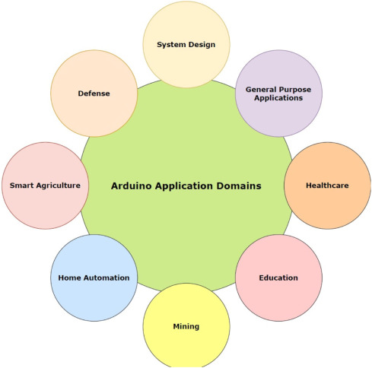
Why Arduino ?

Slide 2
Why Arduino ?
Open Source, both in terms of Hardware and Software.
Cheap(1300र), the hardware can be built from components or a prefab board can be purchased for approx. 900र.
Communicate with a computer via serial connection over USB
Can be powered from USB or standalone DC power
Can run standalone from a computer (chip is programmable) and it has memory (a small amount).
Can work with both Digital and Analog electronic signals.
Sensors and Actuators.
You can make cool stuff! Some people are even making simple robots.

Slide 3
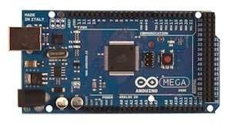
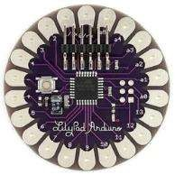
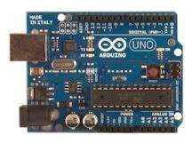
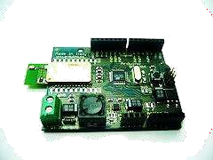
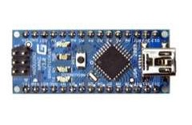
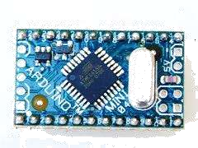
Different types of Arduino boards:
UNO
Mega
LilyPad
Arduino BT
Arduino Nano
Arduino Mini

Slide 4
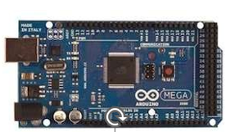
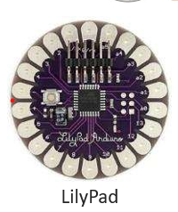
Different types of Arduino boards:
Today Arduino is used for the control of traffic lights, it can also be used for the real time control system with programmable timings, pedestrian lighting etc
UNO
Arduino Mega board are Used in IOT Applications, 3D Printers, temperature sensing, monitoring of real-time applications,
Mega
Robotics. ...
Wearable Technology. ...
Educational Teaching. ...
IoT. ...
Data Logging. ...
3D Mapping & Printing. ...
Automated Gardening

Slide 5
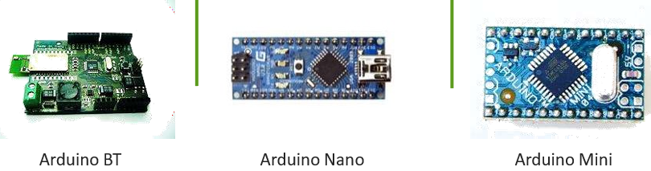
Different types of Arduino boards:
To send the signals and to receive signals in between Smartphone and Arduino hardware
It can be used for almost every task, from minor to massive industrial-scale projects. It can also be used for prototyping and developing new applications

Slide 6
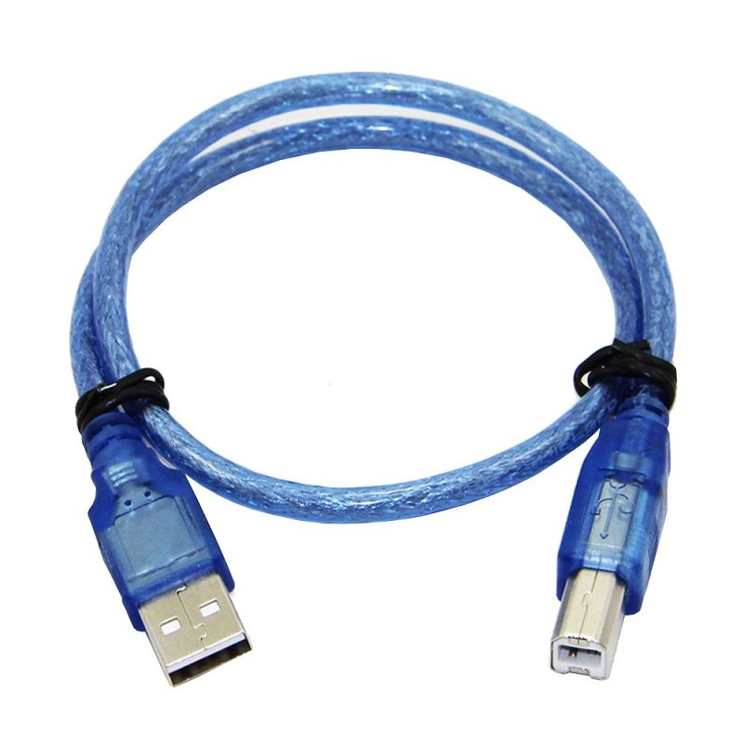
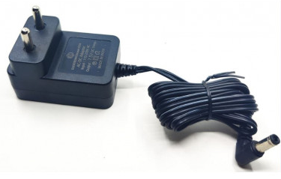
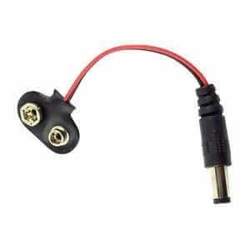
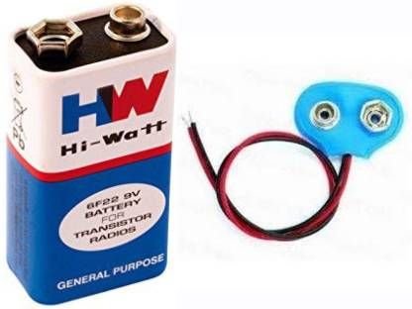
Connectors/Cables to work with Uno:

Slide 7
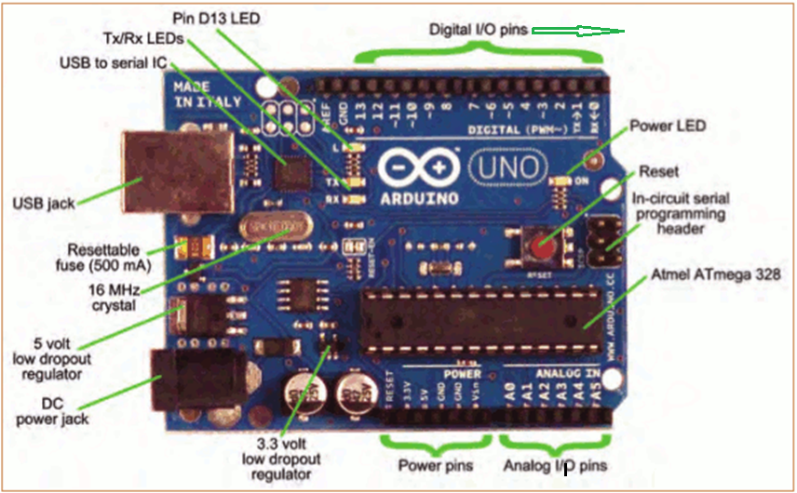
Arduino Uno Board
Digital output
~: PWM.
0,1: Serial port.

Slide 8
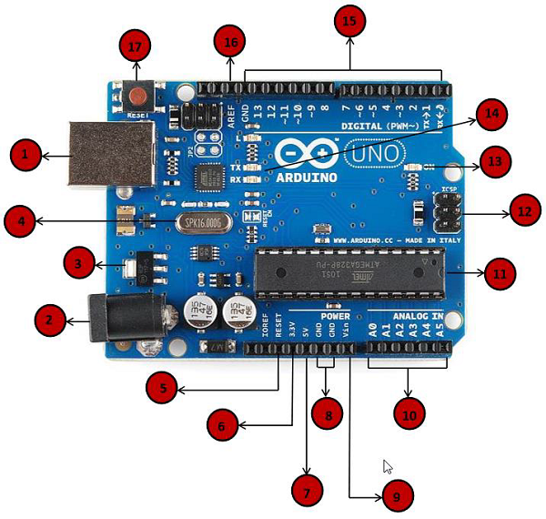
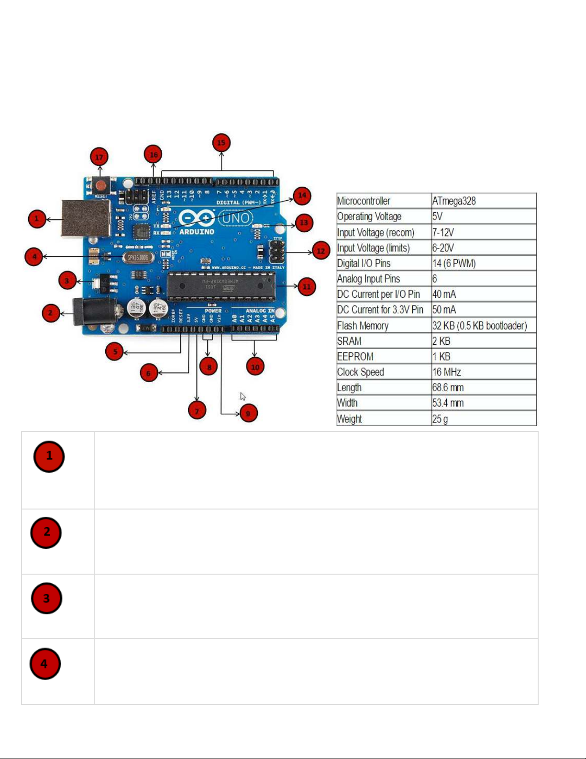
Arduino Board Description

Slide 9
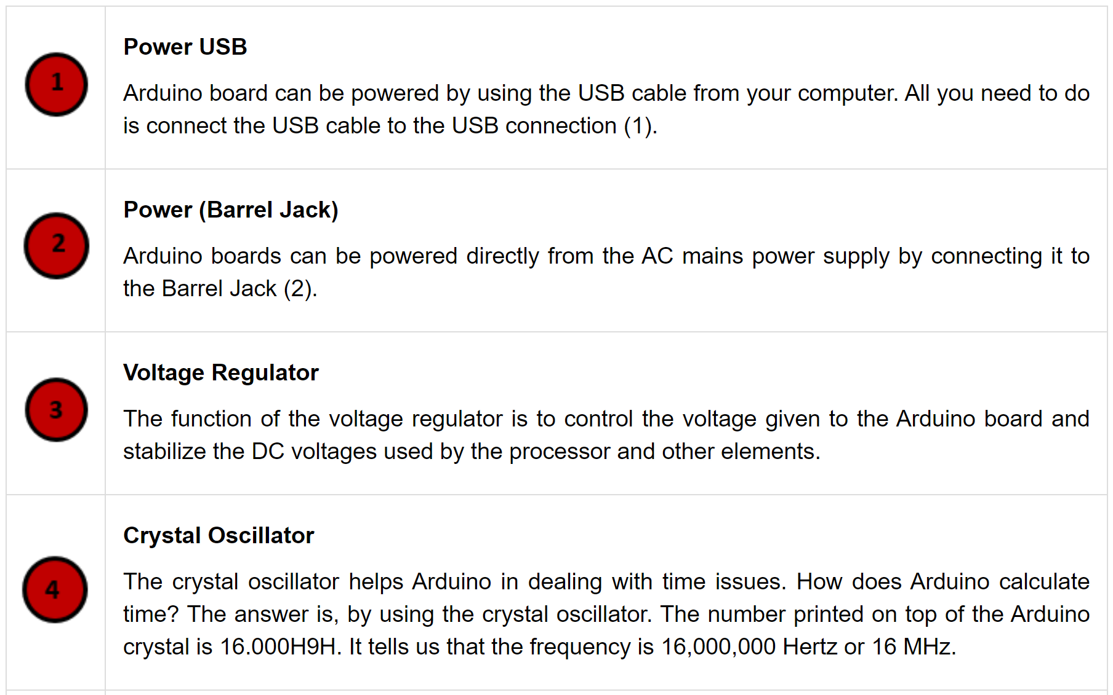
Arduino Board Description (Cont…)

Slide 10
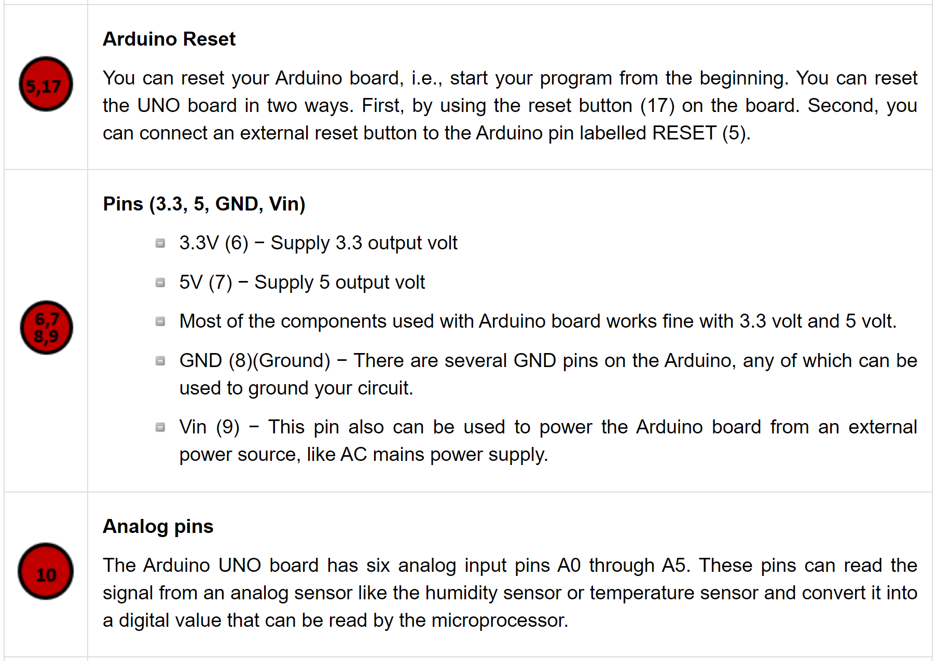
Arduino Board Description (Cont…)

Slide 11
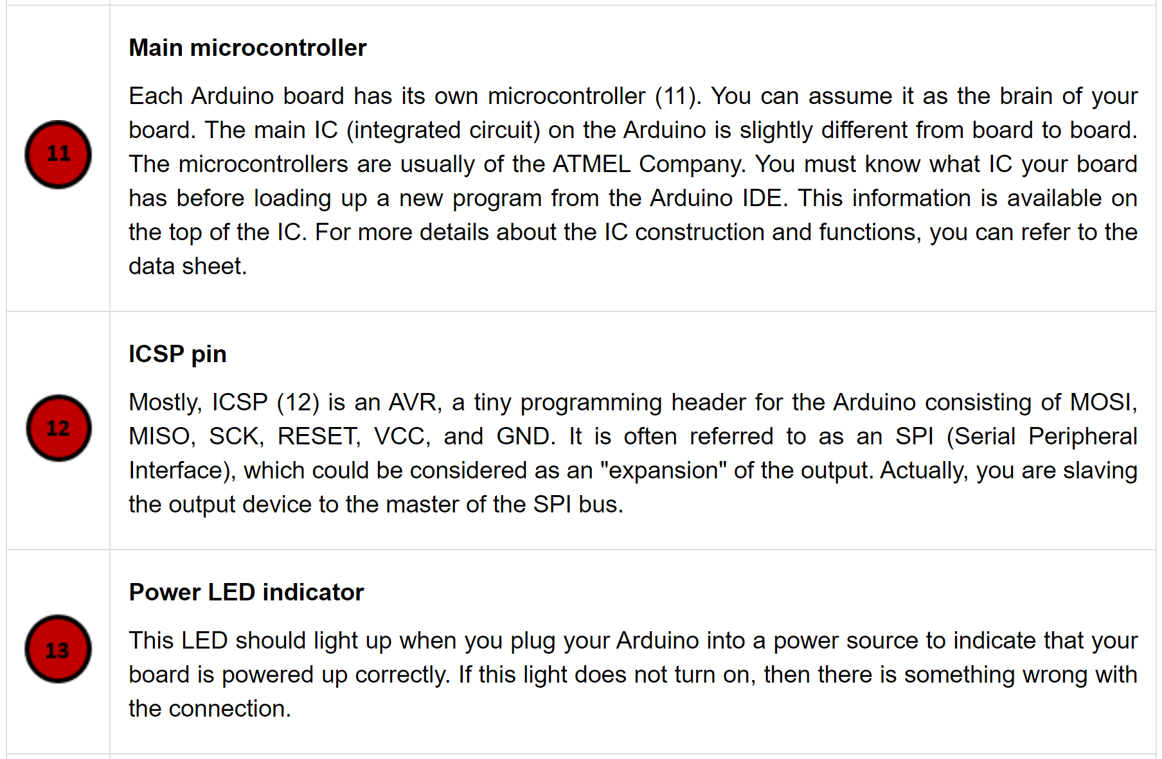
Arduino Board Description (Cont…)

Slide 12
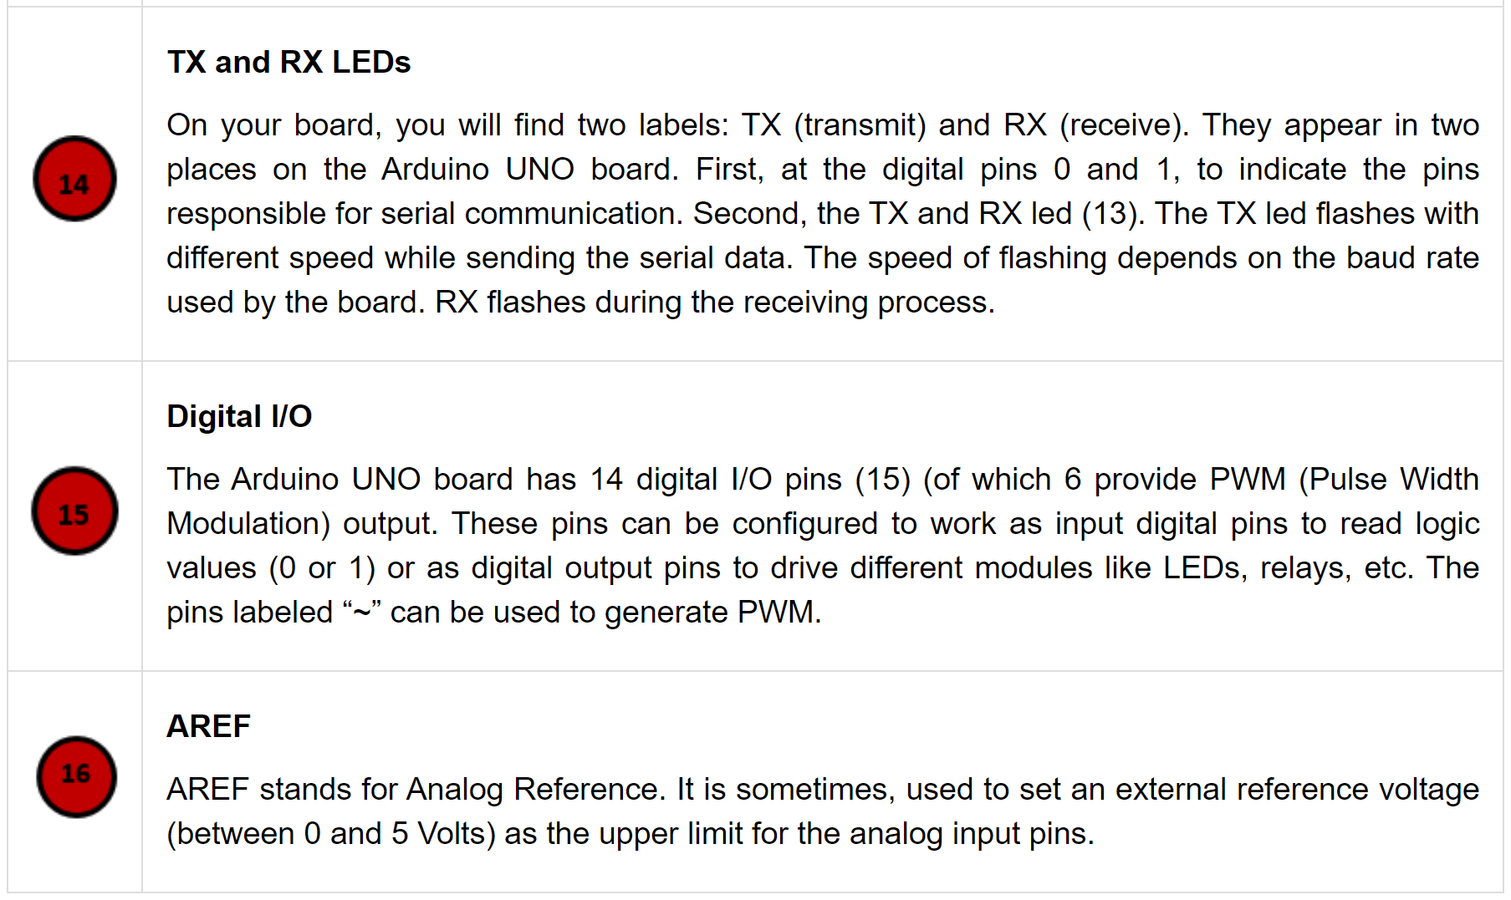
Arduino Board Description (Cont…)
NOTE: Do NOT use a power supply greater than 20 Volts as you will overpower (and thereby destroy) your Arduino.
The recommended voltage for most Arduino models is between 6 and 12 Volts

Slide 13
INPUT v/s OUTPUT
Referenced from the perspective of the microcontroller (electrical board).
Inputs is a signal / information
going into the Arduino board.
Output is any signal exiting the
Arduino board.
Examples: Buttons Switches, Light Sensors, Flex Sensors, Humidity Sensors, Temperature Sensors…
Examples: LEDs, DC motor, servo motor, a piezo buzzer, relay, an RGB LED
https://getintopc.com/softwares/3d-cad/proteus-professional-2020-free-download/

Slide 14
Getting Started (Installing Arduino IDE and Setting-up Arduino Board)
Download & install the Arduino environment (IDE)
Connect the board to your computer via the USB cable
If needed, install the drivers
Launch the Arduino IDE
Select your board
Select your serial port
Open the blink example
Upload the program
https://www.arduino.cc/en/Main/Software

Slide 15
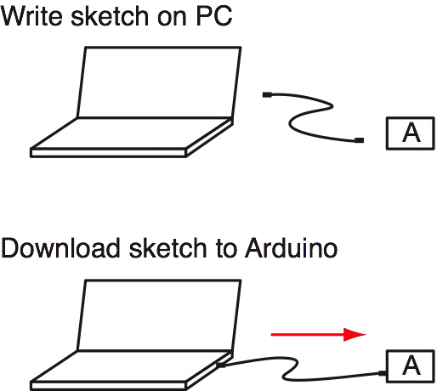
Writing and Uploading Code into Arduino

Slide 16
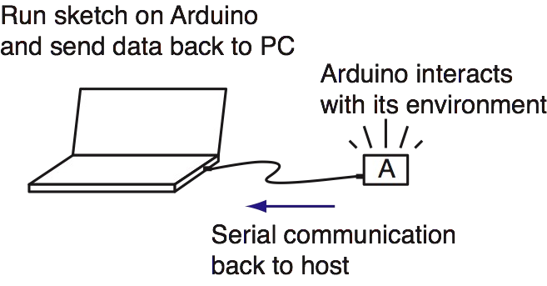
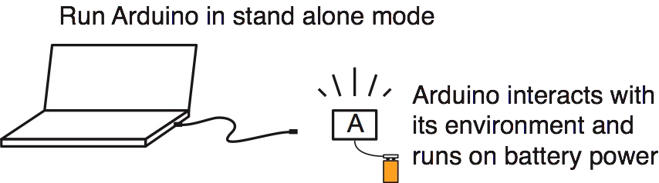
Running Code
Running Code While Tethered
Running Code Stand-Alone

Slide 17
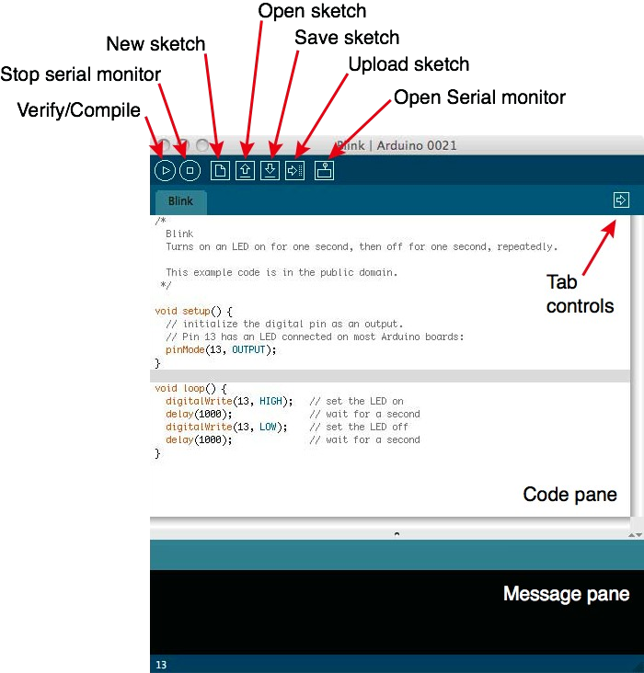
Arduino IDE
IDE =
Integrated Development Environment
http://www.arduino.cc/en/Guide/Environment

Slide 18
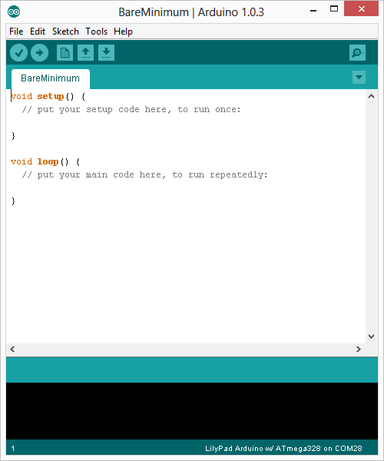
Arduino IDE (Cont..)
Two required functions / methods / routines:
void setup()
{
// runs once
}
void loop()
{
// repeats
}

Slide 19
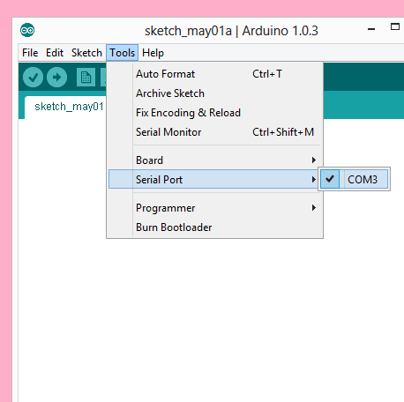
Arduino IDE (Cont..)
Settings: Tools → Serial Port
Your computer communicates to the Arduino microcontroller via a serial port → through a USB- Serial adapter.
Check to make sure that the drivers are properly installed.

Slide 20
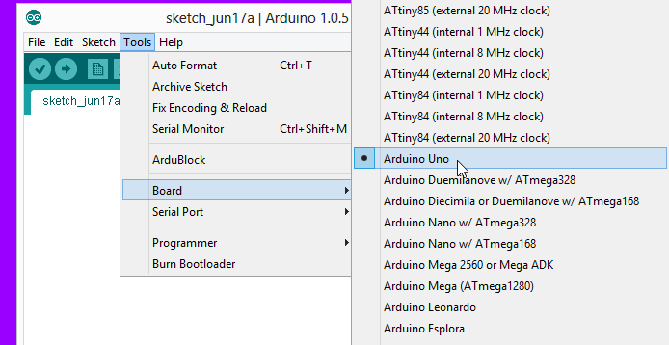
Arduino Cont..
Settings: Tools → Board
Next, double-check that the proper board is selected under the Tools→Board menu.

Slide 21
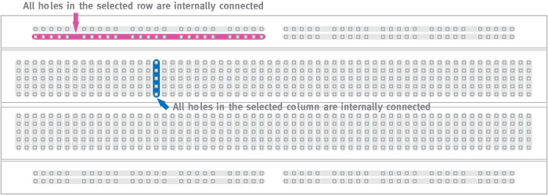
Breadboard Layout

Slide 22
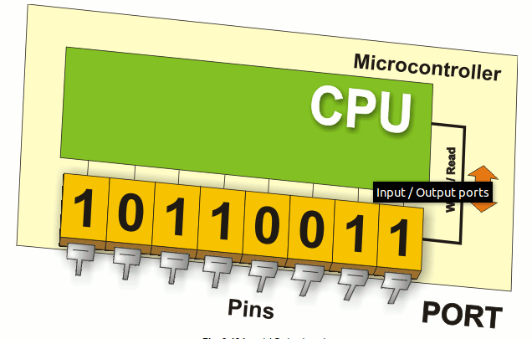
Arduino IDE I/O
pinMode(pin, mode);
Sets pin to either INPUT or OUTPUT
Eg1. pinMode(13, OUTPUT);
digitalRead(pin);
Reads HIGH or LOW from a pin
Eg3. digitalRead(2);
digitalWrite(pin, value);
Writes HIGH or LOW to a pin
Eg2. digitalWrite(13, HIGH);

Slide 23
Our first Arduino Sketch/Program
/*
* Arduino sketch to toggle the LED connected to pin-13 with a rate/delay of 1sec
*/
void setup()
{
// put your setup code here, to run once: -->I*
pinMode(13, OUTPUT); //pin-13 configures as o/p -->II
}
void loop()
{
// put your main code here, to run repeatedly: -->1*
digitalWrite(13, HIGH); //HIGH Value or Bunary-1 send to pin-13 -->2
//delay(x); //x-ms second(s) delay -->3*
//delayMicroseconds(y); //y-us second(s) delay -->4*
delay(1000); //1000-milliseconds=1second delay -->5
digitalWrite(13, LOW); //LOW Value or Bunary-1 send to pin-13 -->6
delay(1000); //1000-milliseconds=1second delay -->7
//Toggling rate of led connected to pin-13 is of 1second -->8*
}

Slide 24
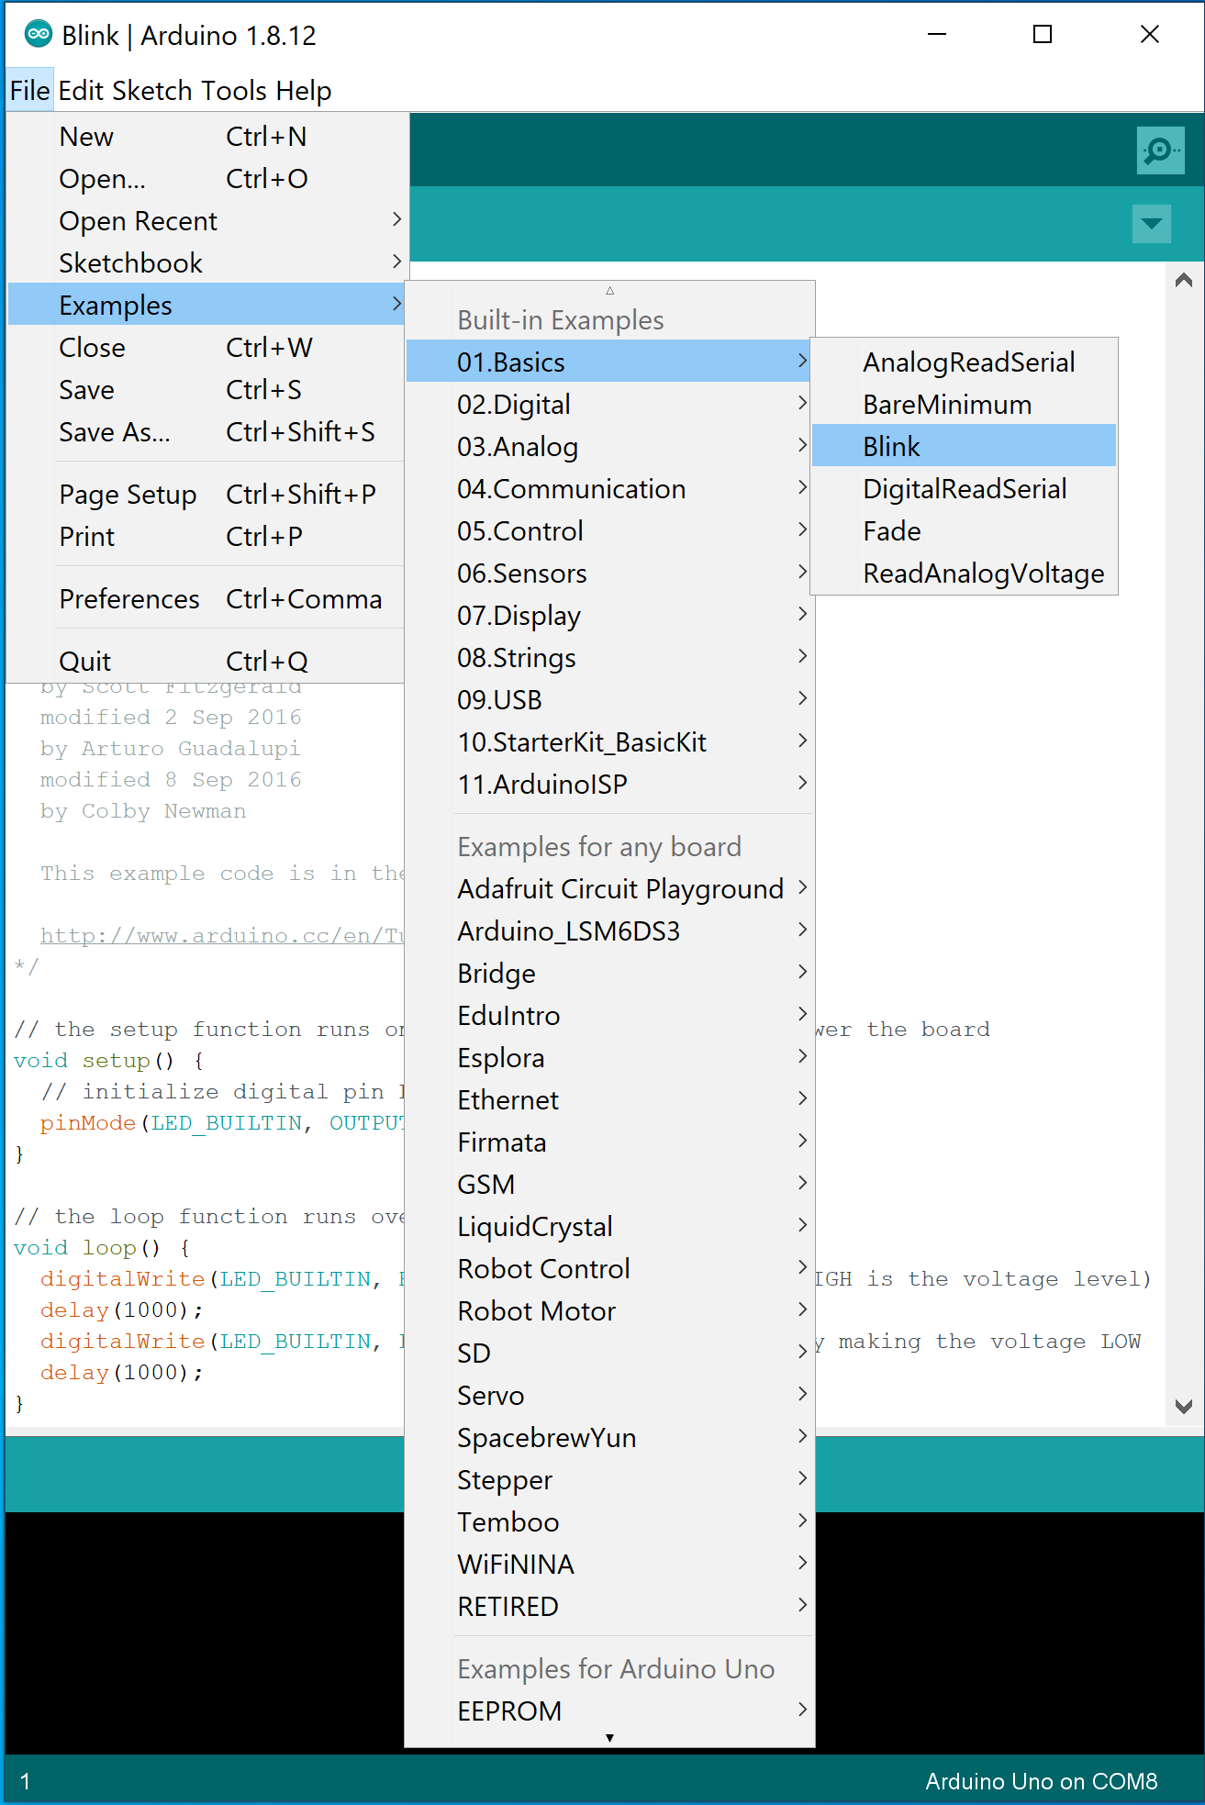
Uploading and Running the blink sketch
In Arduino, open up:
File → Examples → 01.Basics → Blink
const int ledPin = 13; // LED connected to digital pin 13
void setup()
{
pinMode(ledPin, OUTPUT);
}
void loop()
{
digitalWrite(ledPin, HIGH); // set the LED on
delay(2000); // wait for two seconds
digitalWrite(ledPin, LOW); // set the LED off
delay(2000); // wait for two seconds
}

Slide 25
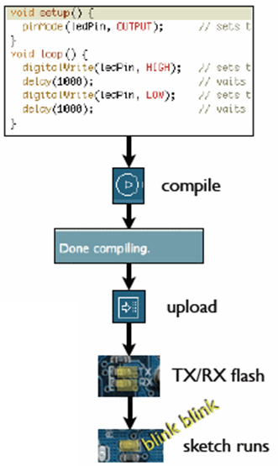
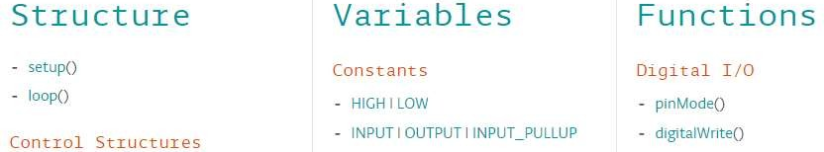
Uploading and Running the blink sketch (Cont..)
Write your sketch/program
Press compile button (to check for errors)
Press upload button to program Arduino board with your sketch
Try it out with the “Blink” sketch!
Arduino programs can be divided in three main parts: Values(Variables & Constants), Structure, and functions.

Slide 26
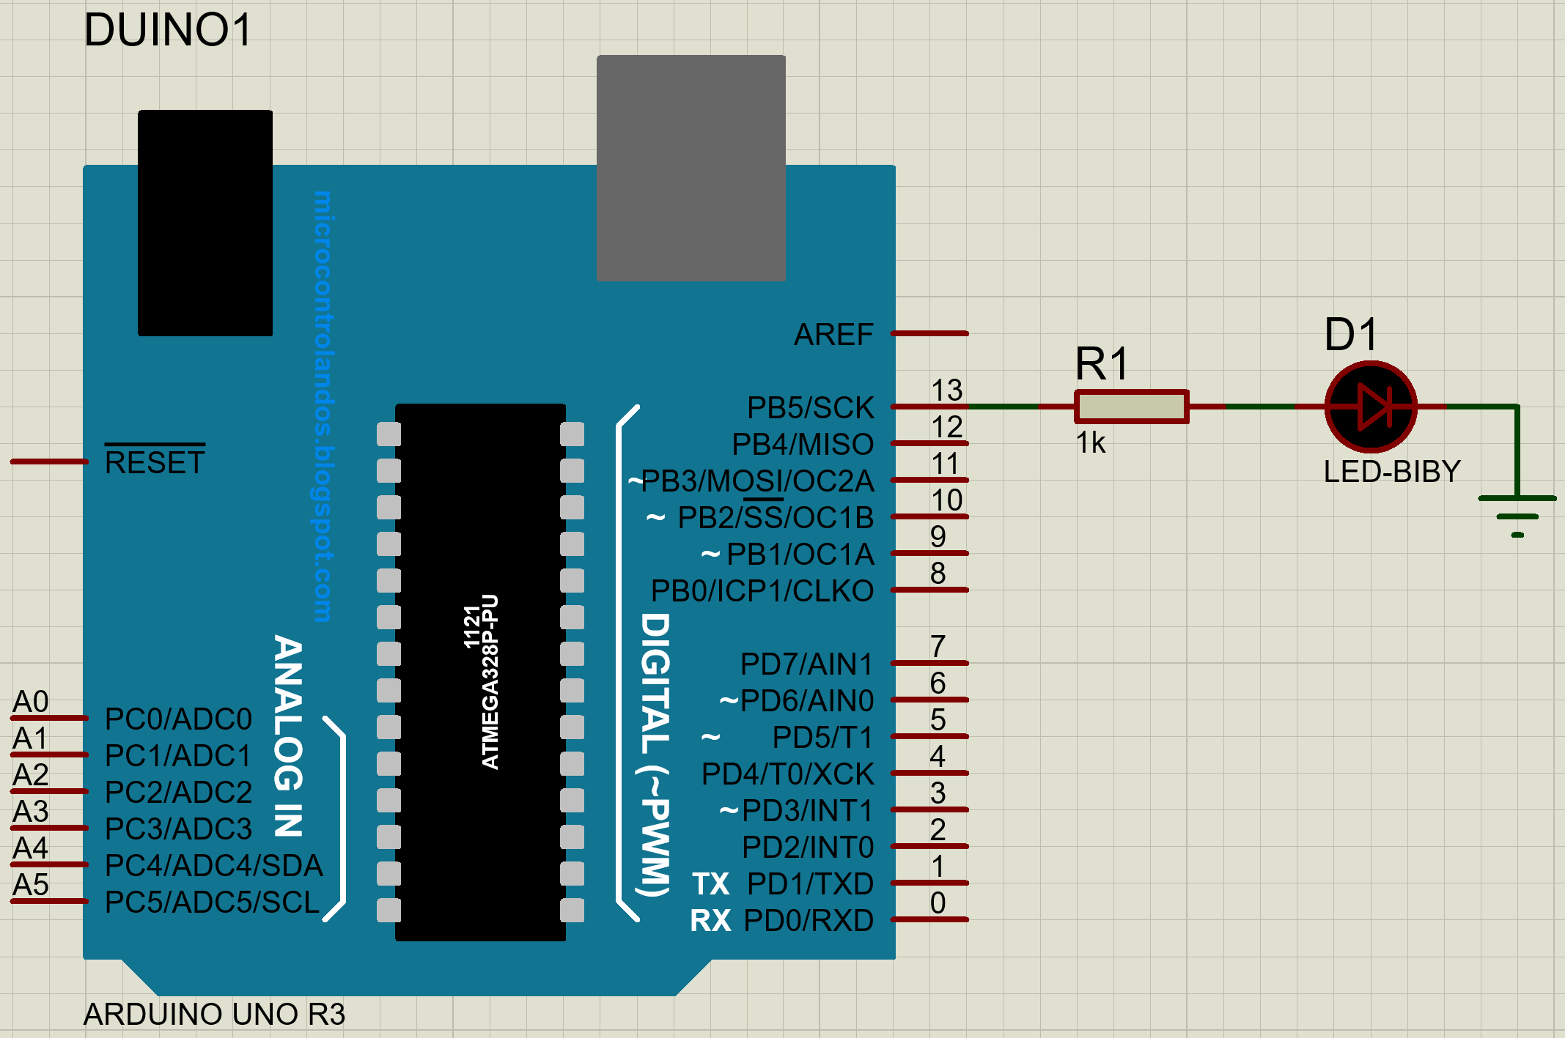
Proteus Design

Slide 27
Data Types and Operators
Integer: used with integer variables with value between 2147483647 and -2147483647.
Eg: int x=1200;
Character: used with single character, represent value from - 127 to 128.
Eg. char c=‘r’;
Long: Long variables are extended size variables for number storage, and store 32 bits (4 bytes), from -2,147,483,648 to 2,147,483,647.
Eg. long u=199203;
Floating-point numbers can be as large as 3.4028235E+38 and as low as -3.4028235E+38. They are stored as 32 bits (4 bytes) of information.
Eg. float num=1.291; [The same as double type]

Slide 28
Statements and operators:
Statement represents a command, it ends with ; Eg: int x; x=13;
Operators are symbols that used to indicate a specific function:
Math operators: [+,-,*,/,%,^]
Logic operators: [==, !=, &&, ||]
Comparison/Boolean operators: [==, >, <, !=, <=, >=]
Syntax:
; Semicolon, {} curly braces,
// single line comment, /*Multi-line comments*/
Boolean Operators:
== (is equal?)
!= (is not equal?)
> (greater than)
>= (greater than or equal)
< (less than)
<= (less than or equal)
Compound Operators:
++ (increment)
-- (decrement)
+= (compound addition)
-= (compound subtraction)
*= (compound multiplication)
/= (compound division)

Slide 29
Control statements:
If Conditioning:
if(condition)
{
statements-1;
…
Statement-N;
}
else if(condition2)
{
Statements;
}
else
{
statements;
}
Switch case:
switch (var)
{
case 1:
//do something when var equals 1 break;
case 2:
//do something when var equals 2 break;
default:
// if nothing else matches, do the default
// default is optional
}

Slide 30
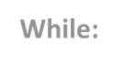

Loop statements:
Do… while:
do
{
Statements;
}
while(condition); While: While(condition)
{ statements; }
for
// the statements are run at least once.
for (int i=0; i <= val; i++)
{
statements;
}
Use break statement to stop the loop whenever needed.

Slide 31
Digital Input
Connect digital input to your Arduino using Pins # 0 – 13 (Although pins # 0 & 1 are also used for programming)
Digital Input needs a pinMode command: pinMode (pinNumber, INPUT); Make sure to use ALL CAPS for INPUT
To get a digital reading:
int buttonState = digitalRead (pinNumber);
Digital Input values are only HIGH (On) or LOW (Off)

Slide 32
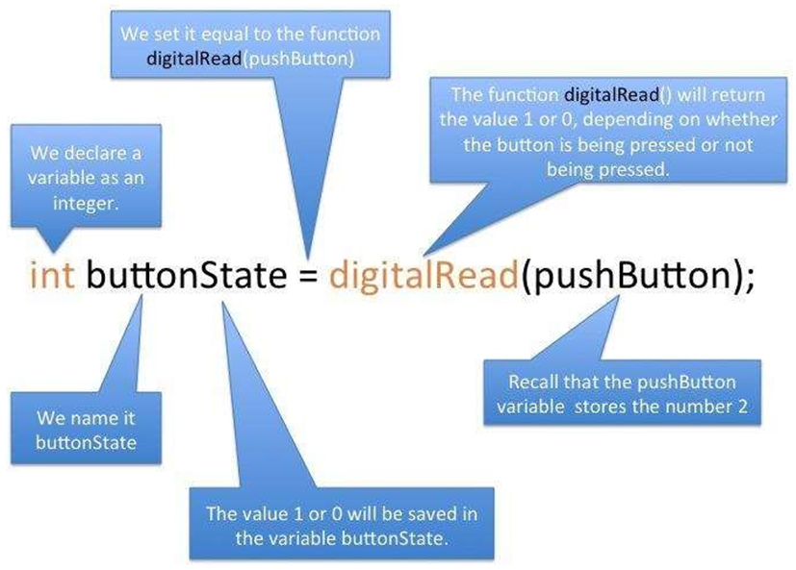
Digital Input (Cont..)

Slide 33
// Pushbutton sketch: a switch is connected to pin 2 lights the LED on pin 13
// (or) Control an LED connected to pin-13 w.r.to. a switch connected to pin-2, with the help of external resister
const int ledPin = 13; // choose the pin for the LED
const int inputPin = 2; // choose the input pin (for a pushbutton)
void setup()
{
pinMode(ledPin, OUTPUT); // declare LED as output
pinMode(inputPin, INPUT); // declare pushbutton as input
}
void loop()
{
int val = digitalRead(inputPin); // read input value
if (val == HIGH) // check if the input is HIGH
{
digitalWrite(ledPin, HIGH); // turn LED on if switch is pressed
}
else
{
digitalWrite(ledPin, LOW); // turn LED off
}
}

Slide 34
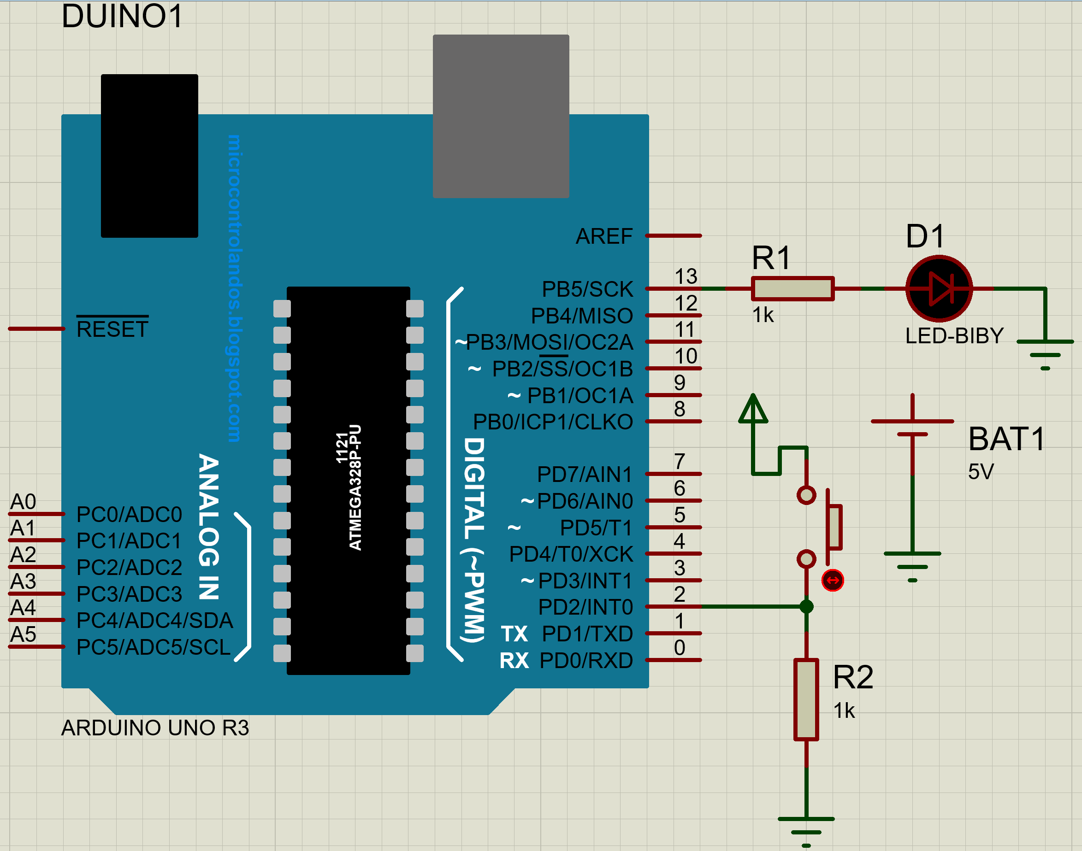
Proteus design (with external resister)

Slide 35
Using a key/push button with external resistor
The digitalRead function monitors the voltage on the input pin (inputPin), and it returns a value of HIGH if the voltage is high (5 volts) and LOW if the voltage is low (0 volts).
Actually, any voltage that is greater than 2.5 volts (half of the voltage powering the chip) is considered HIGH and less than this is treated as LOW.
If the pin is left unconnected (known as floating) the value returned from digitalRead is indeterminate (it may be HIGH or LOW, and it cannot be reliably used).
The resistor shown in Figure shown in previous slide ensures that the voltage on the pin will be low when the switch is not pressed, because the resistor “pulls down” the voltage to ground.
When the switch is pushed, a connection is made between the pin and +5 volts, so the value on the pin interpreted by digital Read changes from LOW to HIGH.

Slide 36
Active Sensors:
RADAR (Radio Detection and Ranging): This sensor emits radio waves that are reflected back by an object, allowing it to determine the distance, speed, and direction of the object.
Lidar (Light Detection and Ranging): This sensor emits pulses of laser light and measures the time it takes for the light to reflect back from an object. This allows it to determine the object's distance and shape.
Ultrasonic Sensor: This sensor emits high-frequency sound waves that bounce off an object and return to the sensor. By measuring the time it takes for the sound waves to return, the sensor can determine the object's distance and position.
Infrared Sensor: This sensor emits infrared radiation and measures the reflection or absorption of the radiation by an object. It is often used in temperature sensors and motion detectors.

Slide 37
Passive Sensors:
Temperature Sensor: This sensor measures the temperature of its surroundings without emitting any energy. Examples include a thermometer or a thermocouple.
Light Sensor: This sensor measures the amount of light in its surroundings without emitting any light of its own. Examples include a photodiode or a photoresistor.
Strain Gauge: This sensor measures the amount of strain or deformation in an object without applying any external force.
Humidity Sensor: This sensor measures the amount of water vapor in the air without emitting any energy.

Slide 38
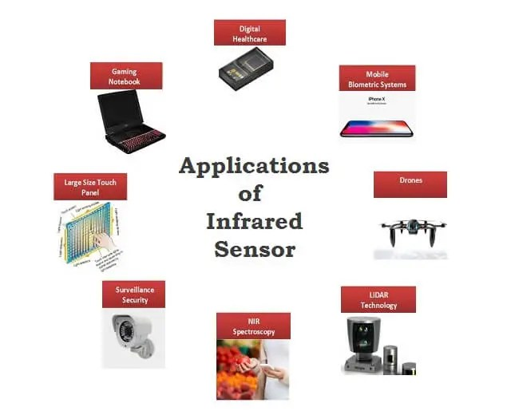
IR Sensor

